Slide 1
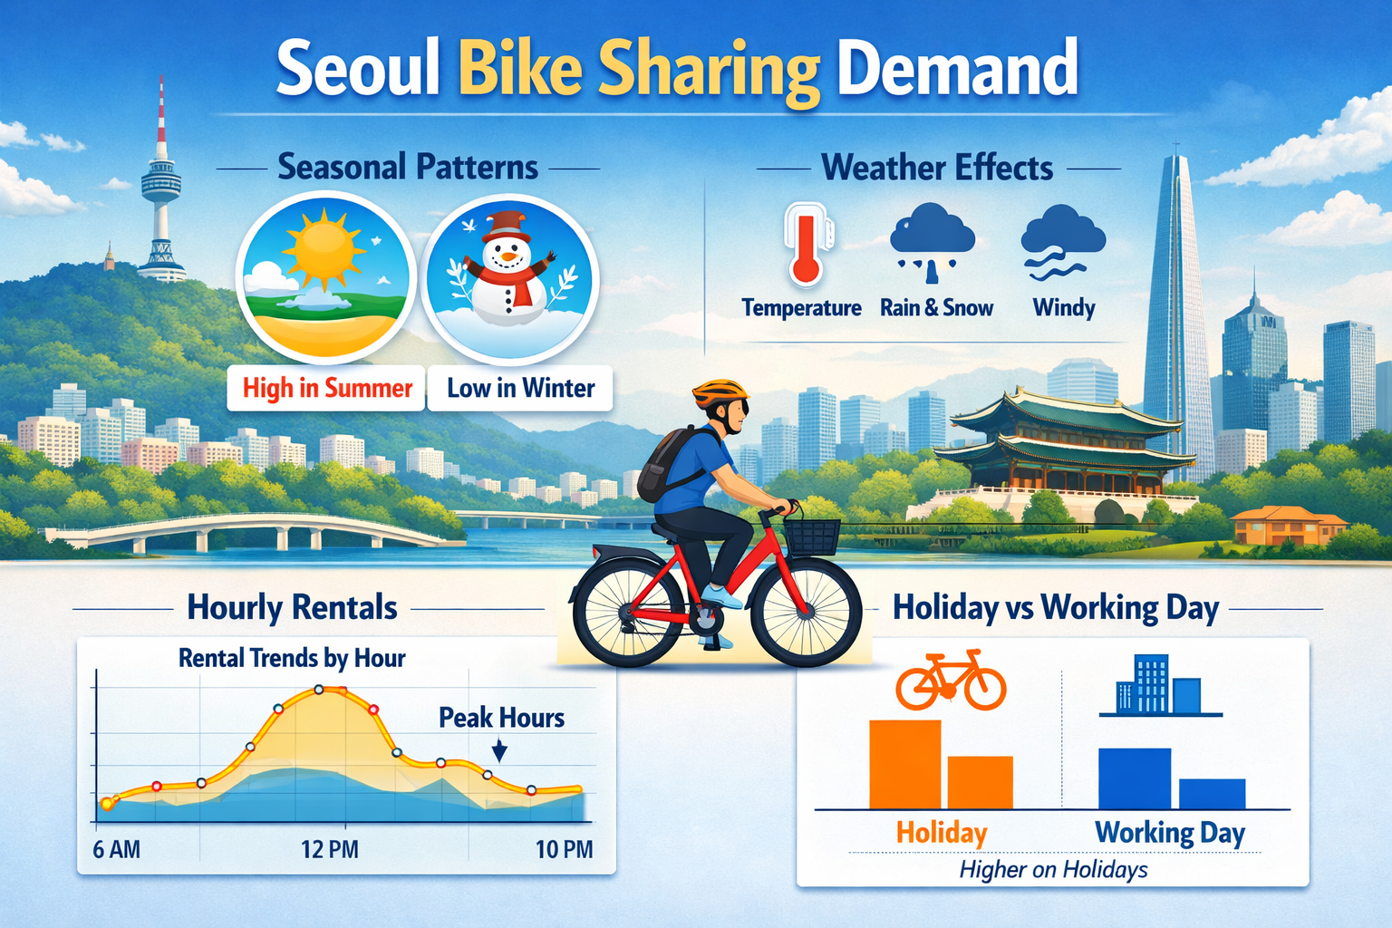
Seoul Bike Dataset
Exploratory Data Analysis(EDA)
Presented by : Geeta Sanjay Torane Guided by : Abhishek Wavhal

Slide 2
Project Summary : The Seoul Bike Data project highlights how weather and time factors shape bike rental demand in the city. By analyzing hourly data with features like temperature, humidity, rainfall, snowfall, and holiday indicators. The study shows that rentals peak during commuting hours, rise in summer and autumn, and drop sharply in bad weather. The temperature and seasonality emerging as the most influential drivers. Overall, the project provides clear insights to improve bike availability, support urban mobility, and promote sustainable transport in Seoul.
Problem Statement : The core problem addressed in the Seoul Bike dataset is the challenge of predicting hourly rental demand so that bikes are available when and where people need them. Demand fluctuates based on weather conditions, seasons, holidays, and commuting hours, making it difficult to maintain an optimal supply. Without accurate forecasting, users may face shortages during peak times or excess bikes during low demand periods. This project aims to build reliable prediction models that help optimize bike distribution, improve urban mobility, and support sustainable transportation planning in Seoul.
Business objective : Seoul Bike dataset project is to accurately forecast hourly rental demand so that bike availability matches user needs across different times and weather conditions. By reduce shortages during peak hours, and avoid excess supply during low-demand periods. Ultimately, this supports efficient urban mobility planning , enhances customer satisfaction, and promotes sustainable transportation solutions in Seoul.

Slide 3
Unique Variables in dataset
1.Rented Bike Count = [254, 204, 173, 107, 78, 100, 181, 460, 930, 4...
2.Hour = [0, 1, 2, 3, 4, 5, 6, 7, 8, 9, 10, 11, 12, 13,...
3. Temperature(°C) = [-5.2, -5.5, -6.0, -6.2, -6.4, -6.6, -7.4, -7....
4.Humidity(%) = [37, 38, 39, 40, 36, 35, 27, 24, 21, 23, 25, 2...
5. Wind speed (m/s) = [2.2, 0.8, 1.0, 0.9, 2.3, 1.5, 1.3, 1.1, 0.5,
6.Visibility (10m) = [2000, 1928, 1996, 1936, 793, 1913, 1687, 1380...
7.Dew point temperature(°C) = [-17.6, -17.7, -18.6, -18.7, -19.5, -19.3, -19...
8.Solar Radiation (MJ/m2) = [0.0, 0.01, 0.23, 0.65, 0.94, 1.11, 1.16, 1.01...
9.Rainfall(mm) = [0.0, 0.5, 1.0, 2.5, 0.1, 0.2, 0.3, 0.7, 1.6, ...
10.Snowfall (cm) = [0.0, 0.1, 0.3, 0.4, 0.2, 1.0, 0.9, 0.8, 0.7, ...
11.Seasons = [Winter, Spring, Summer, Autumn]
12.Holiday = [No Holiday, Holiday]
13. Functioning Day = [Yes, No]
14.Day = [1, 2, 3, 4, 5, 6, 7, 8, 9, 10, 11, 12, 13, 14...
15.Month = [12, 1, 2, 3, 4, 5, 6, 7, 8, 9, 10, 11]
16.Year = [2017, 2018]
17.WeekDay = [Friday, Saturday, Sunday, Monday, Tuesday, We...

Slide 4
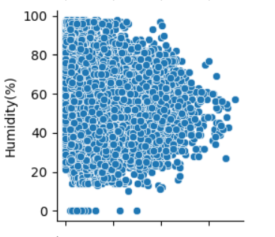
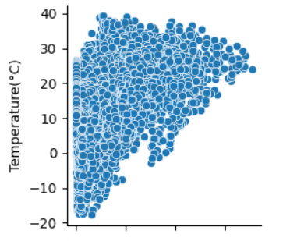
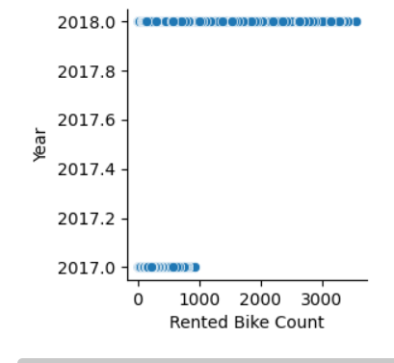
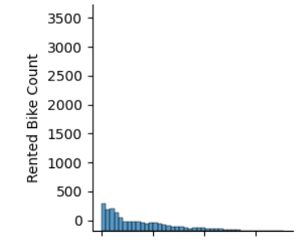
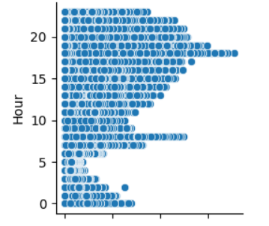
Raw data Total - 8760 Rows & 14 Columns
Created Day , Month , Year column & Date column deleted then I Reset index
Now we having total 18 Columns & 8760 Rows
No duplicate values found
No null records found

Slide 5
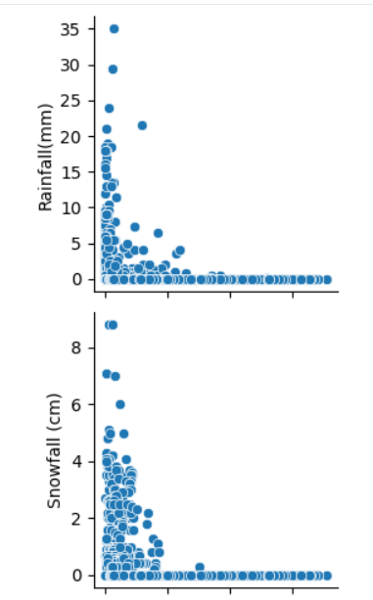
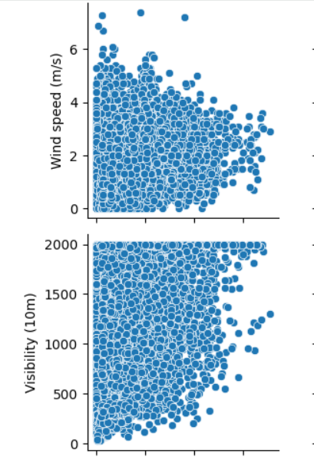
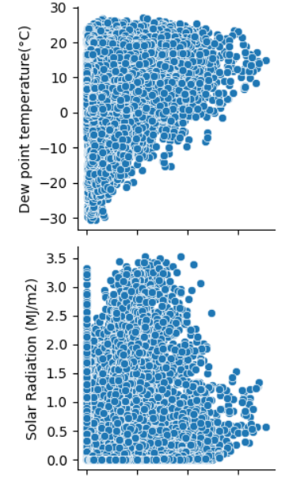
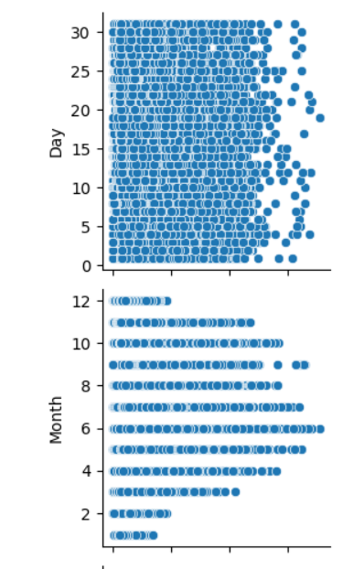

Slide 6
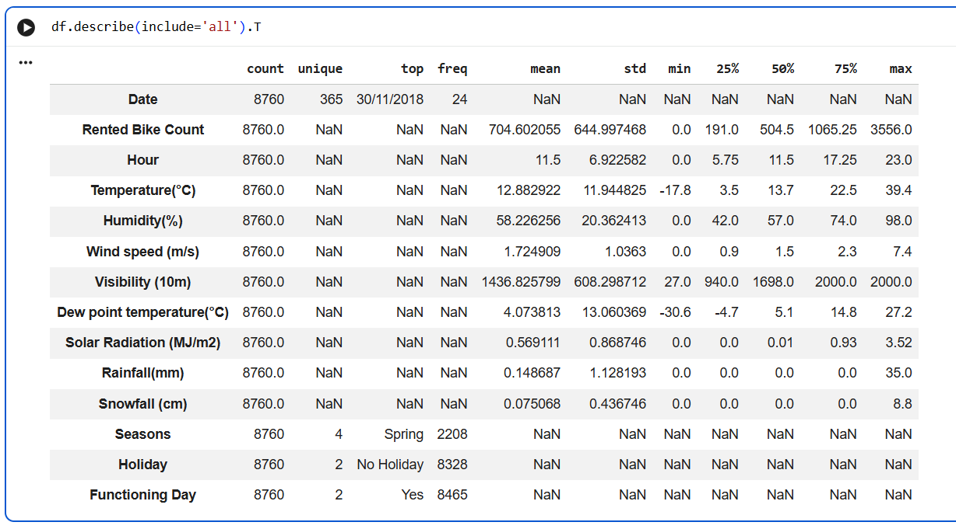

Slide 7
✅ From the above pair plot I found that in year 2017 rented bike count decrease & in year 2018 rented bike count is increase.
✅ In month 2 & 10 bike demand decrease and in 6th month bike demand increase.
✅ whenever snowfall demand is increased between o to 4 & rainfall demand between 0 to 5 increase or equitable
✅ we can say snowfall and rainfall not impacting drastically on demands of rented bike.
✅ solar radiation and dew point temperature shows that temperature decreases the bike demand increases.
✅ As the visibility in bike demand increase and vice versa of this.
✅ Humidity between 20 to 80% demand is scale is high but at 0% low.
✅ wind speed not affecting much to bike demand.
✅ Hour 18 and 8 shows bike demand is high but at 4 - 5 Hour bike demand low.
✅ Rented bike demand in dataset showing decreasing.

Slide 8
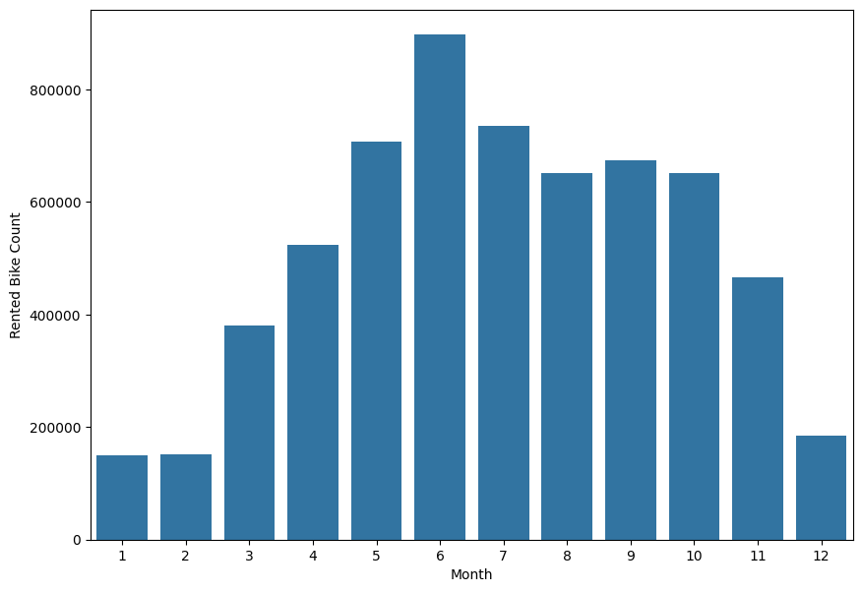
✅ Above Bar plot shows 6 that is July month having highest number of rented bike count and growing market demand during early summer .
✅ month January and February showing lowest demand of bike in Seoul due to snowfall or other weather conditions reduces demand
✅ High demand from May to October as the favourable weather boosts usage.
✅ Gradual rise from winter to summer, then decline toward winter its clear seasonal pattern

Slide 9
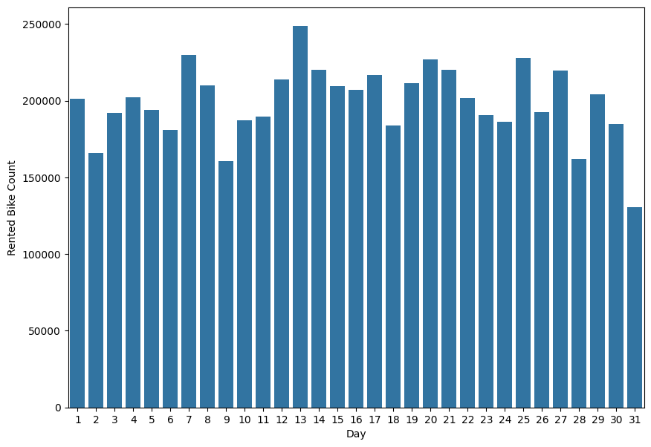
✅ Day 13 showcasing major demand fairly consistent across days of rented bikes.
✅ Day 9 and 31 shows less demand compare with other days. may be due to external factors (weather/holidays)
✅ Slight peaks around mid-month (13-15, 20-25) , possible salary period or increased activity

Slide 10
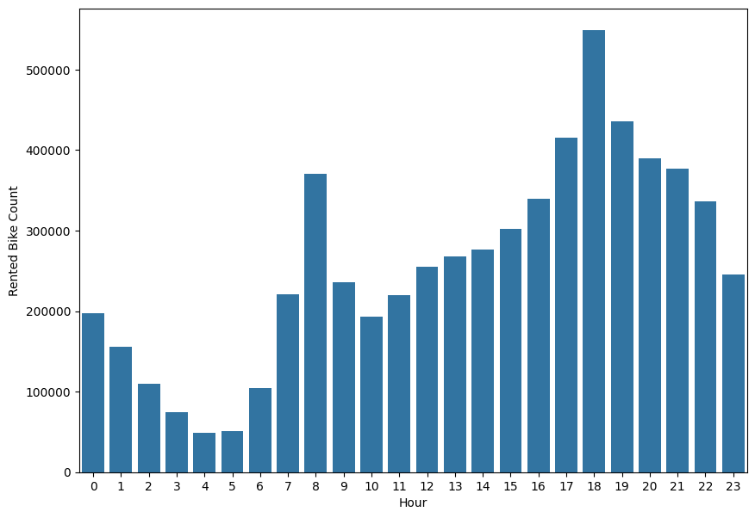
✅ Hour 17-19 (means 5-7 Pm ) representing high bike demands. highest rentals, likely office commute time
✅ Hour 4 and 5 o'clock lowest bike demand in city, minimal usage during late night or early morning
✅ Morning peak around 8 AM, secondary spike (work/school travel)
✅ Demand steadily rises from noon to evening, strong afternoon usage pattern
✅ Post 7 PM decline , rentals decrease after peak hours

Slide 11
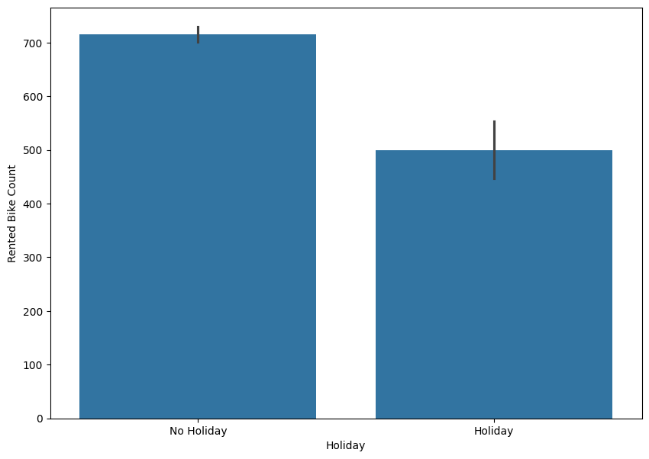
✅ On No holiday means working days the 200 bikes is extra high demand compare with holiday

Slide 12
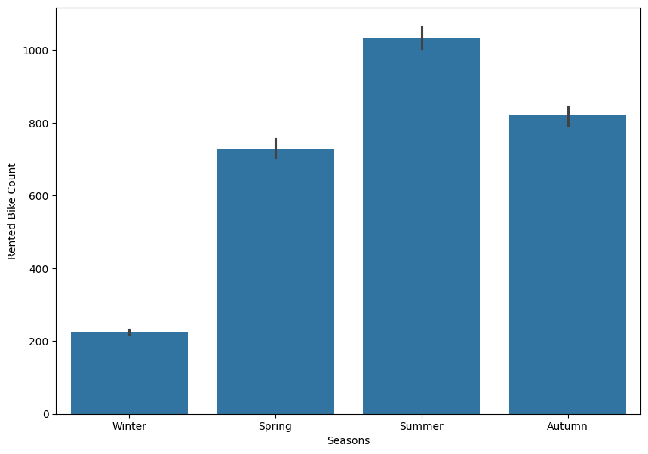
✅ we having four seasons winter, spring, summer, autumn
✅ Summer season shows high demand for the rented bike as there is less rainfall and snowfall in city.
✅ winter season reflects snowfall in Seoul so the demand for bike also decreases.
✅ Spring and autumn seasons have medium level of bike demand.

Slide 13
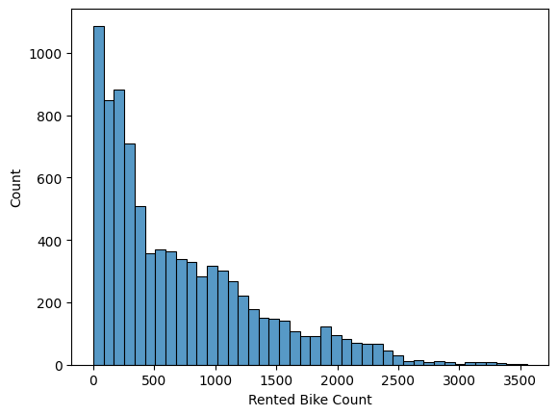
✅ The distribution is right-skewed , meaning most days have lower rented bike counts, with a few days showing very high demand.
There is a long tail , indicating occasional spikes in rentals, likely due to factors like weather, holidays, or events.

Slide 14
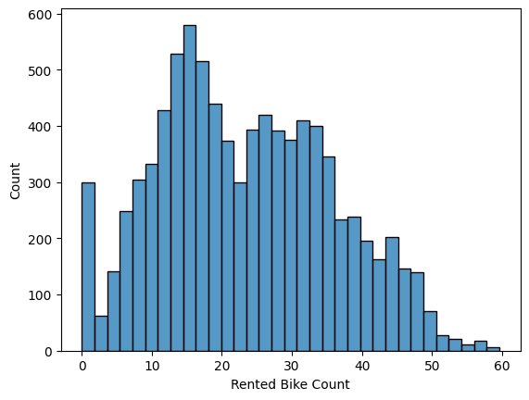
✅ The peak rental activity occurs around 15 bikes, showing this is the most common demand level.
✅ The distribution is right-skewed , meaning higher rental counts are rare compared to lower ones.
✅ Rentals above 40 bikes are very infrequent , highlighting limited instances of high demand.
✅ The histogram suggests that small to moderate rentals dominate usage patterns , useful for resource planning.

Slide 15
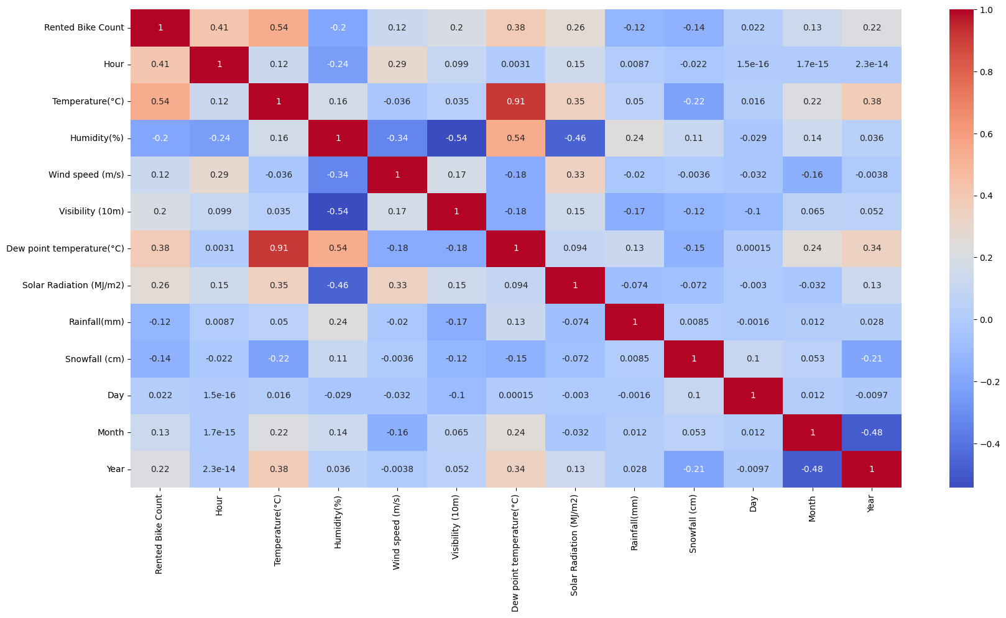

Slide 16
Insights from Heat map
✅ Temperature (0.54) & Dew Point (0.38) show strong positive correlation with bike rentals , warmer conditions significantly increase demand.
✅ Humidity (-0.20), Snowfall (-0.14), Rainfall (-0.12) negatively impact rentals , bad weather reduces usage.
✅ Hour (0.41) has a good positive correlation , rentals depend heavily on time of day (peak hours matter).
✅ Solar Radiation (0.26) & Visibility (0.20) positively influence demand , clearer, sunnier days boost rentals.
✅ Temperature & Dew Point (0.91) are highly correlated , avoid using both together to prevent multicollinearity.

Slide 17
Conclusion
✅ Focus on peak hours (8 AM & 5-7 PM) it ensure maximum bike availability during commute times
✅ Leverage summer months (May-Oct) could run promotions, expand fleet, and increase pricing strategically
✅ Reduce impact of bad weather by offering discounts or incentives during rain, snow, or high humidity
✅ Use weather-based demand prediction for better Planning operations based on temperature & clear weather conditions
✅ Optimize low-demand periods (night/winter) by introduce offers, subscriptions, or alternate use cases
✅ Final Strategy is Combine time , weather & seasonality to maximize demand, pricing, and bike availability
Thank you.

